Slide 1
Lectures on HPC/Parallel Computing Lecture 4
Andrew Pensoneault

Slide 2
Overview
Intro to OpenMP

Slide 3
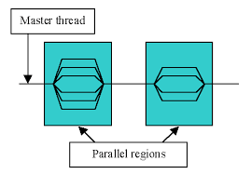
INTRO to OpenMP
OpenMP provides a portable, scalable model for developers of shared memory parallel applications
What OpenMP is not:
Meant for distributed memory parallel systems (by itself)
Guaranteed to make the most efficient use of shared memory
Required to check for data dependencies, data conflicts, race conditions, or deadlocks
Designed to guarantee that input or output to the same file is synchronous when executed in parallel. The programmer is responsible for synchronizing input and output.

Slide 4
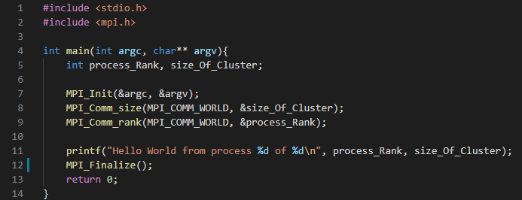
OpenMP Hello WOrld Program in C
To compile the program run the command
$ mpicc mpi_helloworld.c –o mpihelloworld
To run the program run the command
$ mpirun –np 4 ./helloworld

Slide 5
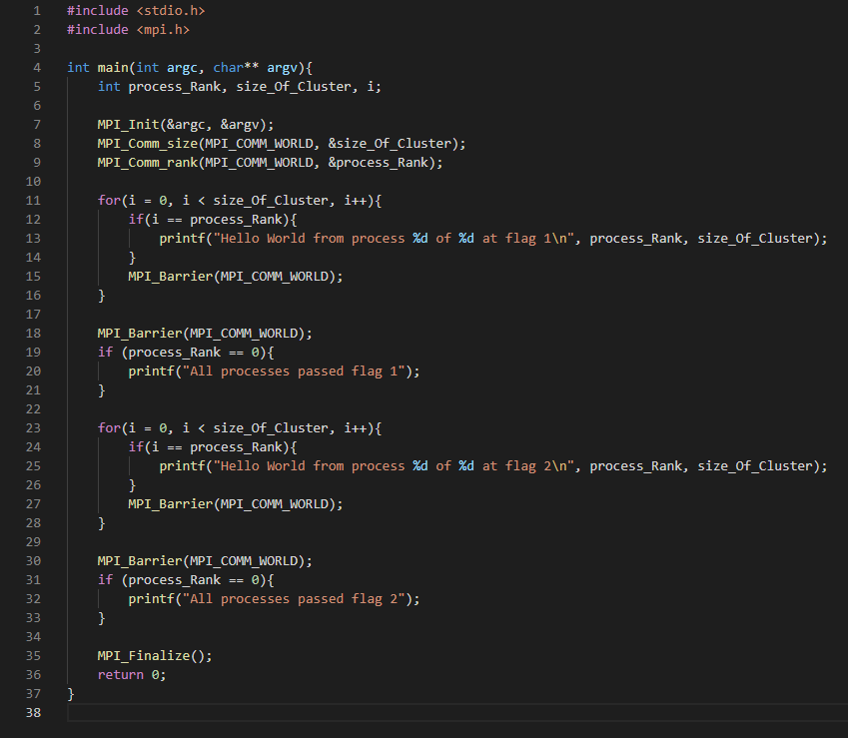
Synchronization with MPI
When a program is running, MPI starts a specified number of copies of the program running in parallel, and each process operates independently of the rest
To ensure thread safety, once a process reaches a point, we may wish to have it wait.
MPI_Barrier(): This function blocks all MPI processes in the given communicator until they all call this routine.

Slide 6
Message Passing with MPI
We can enable passaging of messages between multiple processes via the following functions
MPI_Send(const void* buffer_send,
int count_send,
MPI_Datatype datatype_send,
void* buffer_recv,
int count_recv,
MPI_Datatype datatype_recv,
int root,
MPI_Comm communicator)
buffer_send - The buffer containing the data to dispatch from the root process.
count_send - The number of elements to send to each process, not the total number of elements in the send buffer. For non-root processes, the send parameters like this one are ignored.
datatype_send - The type of one send buffer element. For non-root processes, the send parameters like this one are ignored.
buffer_recv - The buffer in which store the data dispatched.
count_recv - The number of elements in the receive buffer.
datatype_recv - The type of one receive buffer element. root The rank of the root process, which will dispatch the data to scatter.
Communicator - The communicator in which the scatter takes place.

Slide 7
Message Passing with MPI
We can enable passaging of messages between multiple processes via the following functions
MPI_recv(void* buffer,
int count,
MPI_Datatype datatype,
int sender,
int tag,
MPI_Comm communicator,
MPI_Status* status);
Buffer - The buffer in which receive the message.
Count - The number of elements in the buffer given. The number of elements in the message to receive must therefore be less than or equal to that value.
Datatype - The type of one buffer element.
Sender - The rank of the sender MPI process. If there is no restriction on the sender's rank, MPI_ANY_SOURCE can be passed.
tag - The tag to require from the message. If no tag is required, MPI_ANY_TAG can be passed.
communicator - The communicator in which the communication takes place.
status - The variable in which store the status of the receive operation. Pass MPI_STATUS_IGNORE if unused.

Slide 8
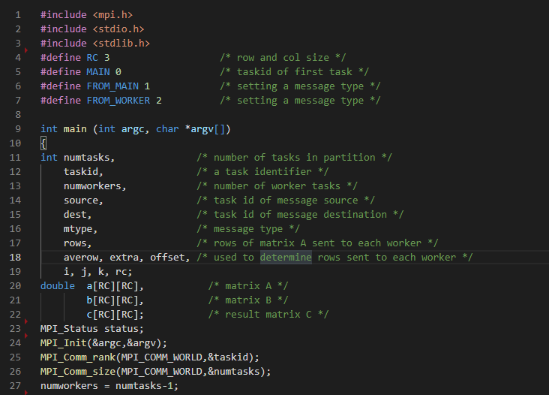
Matrix Multiplication

Slide 9
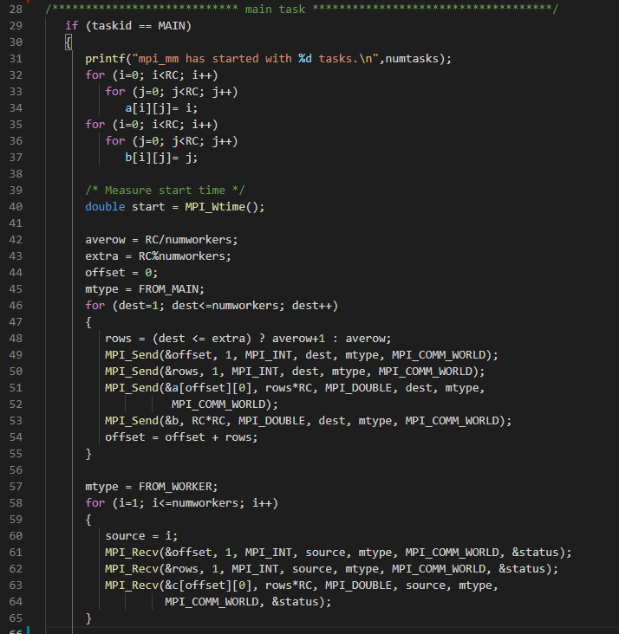
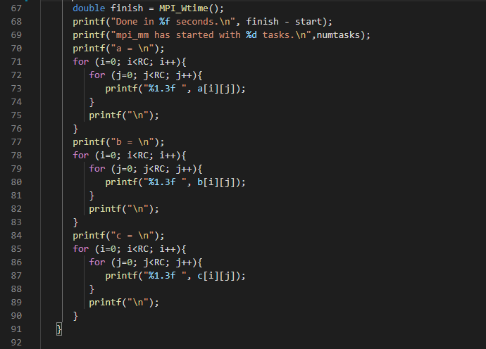
Matrix Multiplication

Slide 10
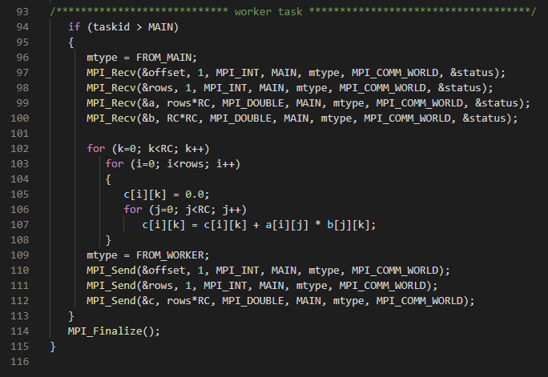
Matrix Multiplication

Slide 11
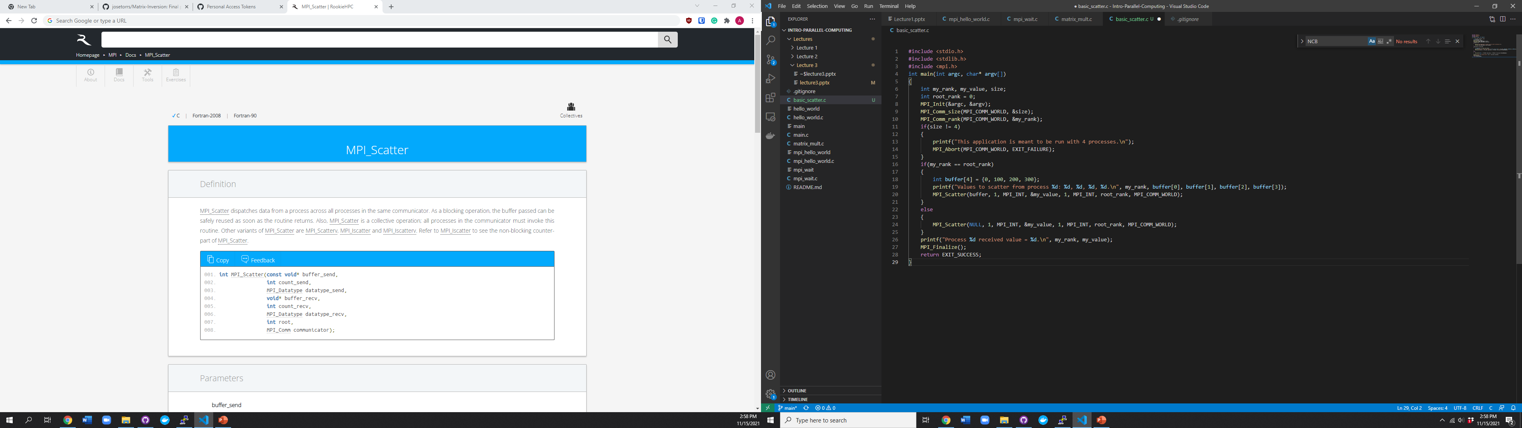
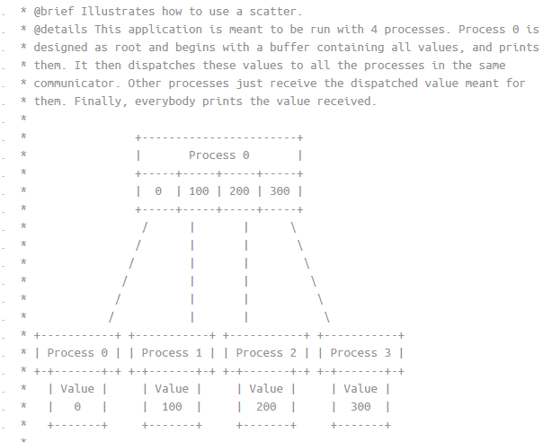
MPI_scatter

Slide 12
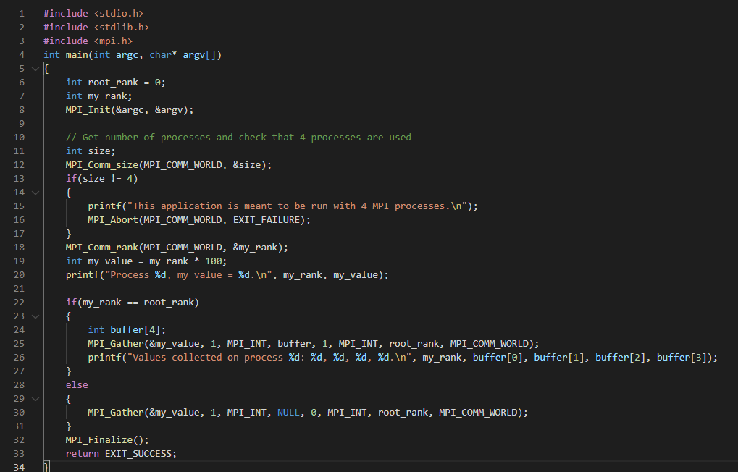
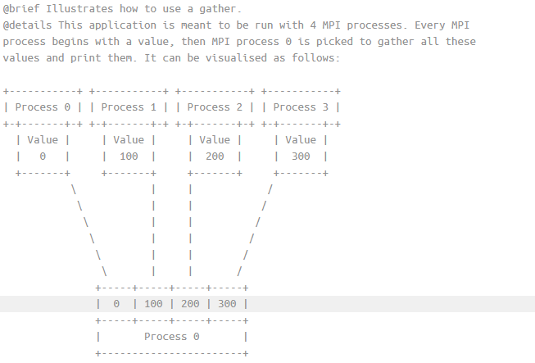
MPI_gATHER

